Slide 1

Unveiling Insights Analyzing Factors Influencing Alcohol Purchases in Iowa for DEAD
Martin Hsu, Andrew Kerr, Erik Luu, Matteo Shafer, and Isabella McCarty

Slide 2
INTRODUCTION
D.E.A.D MISSION
ANALYSIS OBJECTIVES
DATA COMMUNICATION
Notes:
BELLA – Drinking Excess Alcohol is Dangerous (DEAD) is interested in the driving factors behind small and large alcohol purchases in Iowa. We propose a machine learning model fitting a multiple linear regression model to a random sample of past sales data. The model will fit sales data and predict the quantity of alcohol sold. The features of the final model will represent the most influential factors driving alcohol purchasing behavior.

Slide 3
PROJECT SCOPE -DATA COLLECTION-
IOWA LIQUOR SALES API
RANDOM SAMPLING AND QUERIES
HOLIDAYS AND IOWA COLLEGES
INTRODUCTION OF POSSIBLE FACTORS
FEATURE ENGINEERING
ANALYTICAL METHODS AND CUSTOM FACTORS
Notes:
ANDREW
API:
- Random sample of 100k store purchases of alcohol from 2022-2023
Holiday & Colleges:
- Collected past days of government-observed holidays as well as colleges in each city along with student enrollment
Engineered Features:
- Categorization of general liquor types (e.g. Vodaka, Brandy, Rum)
- Whether the store purchase was within 2 weeks prior to government-observed holidays
- Count of colleges in city where store is located
- Categorization of size of student population in city: Small, Med, Large

Slide 4
PROJECT SCOPE -MODEL FITTING-
MODEL RANKING | FEATURES IN MODEL
1 | LIQUOR CATEGORY, HOLIDAY, COST PER LITER, COLLEGE COUNT
2 | LIQUOR CATEGORY, HOLIDAY, COST PER LITER, STUDENT POPULATION
3 | LIQUOR CATEGORY, HOLIDAY, COST PER LITER, STUDENT POPULATION, DAY OF THE WEEK
4 | LIQUOR CATEGORY, HOLIDAY, COLLEGE COUNT, DAY OF THE WEEK, MONTH, COUNTY, SIZE OF STUDENT POPULATION
5 | LIQUOR CATEGORY, HOLIDAY, COLLEGE COUNT, DAY OF THE WEEK, MONTH, SIZE OF STUDENT POPULATION
MODEL CHOICE: LINEAR REGRESSION MODEL WITH PENALIZATION TERM
VARIOUS COMBINATIONS OF FEATURES TESTED IN THIS MODEL
VALIDATION METRIC TO MAKE INTER-MODEL COMPARISONS
Notes:
BELLA

Slide 5
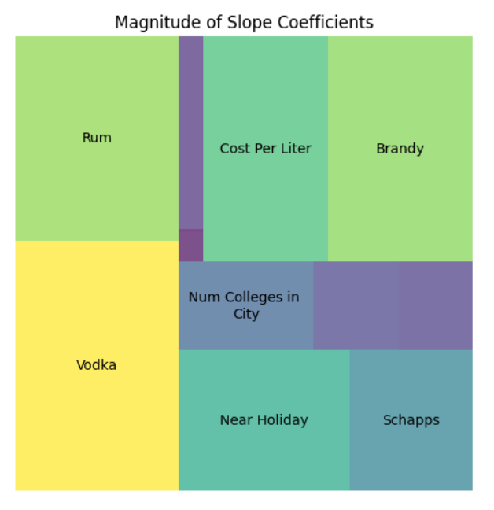
KEY FINDINGS
FEATURES THAT LEAD TO LARGER ALCOHOL PURCHASES
VODKA, RUM, HOLIDAY
FEATURES THAT LEAD TO SMALLER ALCOHOL PURCHASES
BRANDY, COST PER LITER
NOTABLE FEATURES
SCHNAPPS, COLLEGE COUNT
Notes:
ANDREW
Graph:
- Size of rectangles indicates the power of the factor – how much this factor influences the amount of liters bought by the store (ignoring whether they caused an increase or decrease)
Interpretations:
- When buying liquor, stores tend to buy larger quantities of vodka and rum and lower quantities of brandy -
- Stores tend to buy more alcohol around holidays
- Stores tend to buy less expensive alcohol --> stores sell more cheap than expensive alcohol

Slide 6
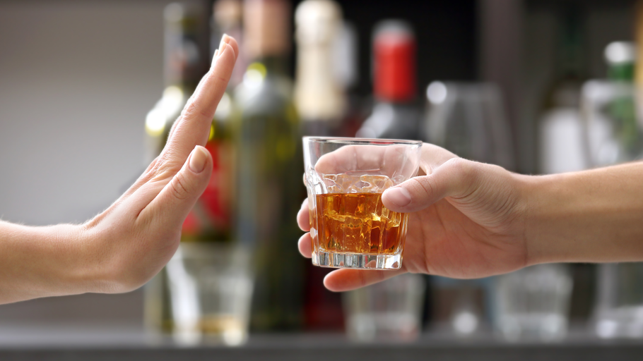
RECOMMENDATIONS
ACTIONABLE RECOMMENDATIONS TO PROMOTE SAFER ALCHOL CULTURE IN IOWA
This Photo by Unknown Author is licensed under CC BY-NC-ND
Notes:
BELLA

